Slide 1
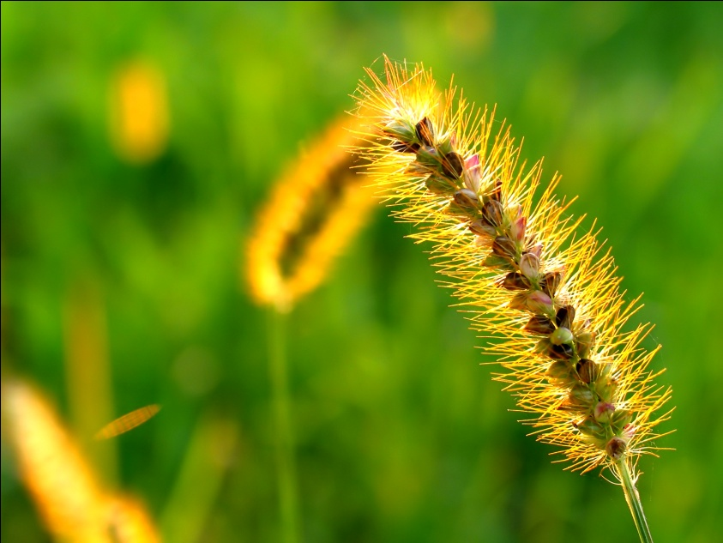

DECISION TREE: INFORMATION GAIN BASED CRITERION SELECTION
DATA MINING
CLASSIFICATION

Slide 2
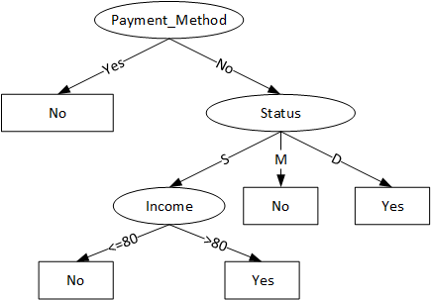
Decision Tree
The use of
Hunt Algorithm

Slide 3


Is that simple?
Of course not!!!!

Slide 4

How to find the best attribute ?
Attribute Selection
Information Gain
Gain Ratio
Gini Index

Slide 5
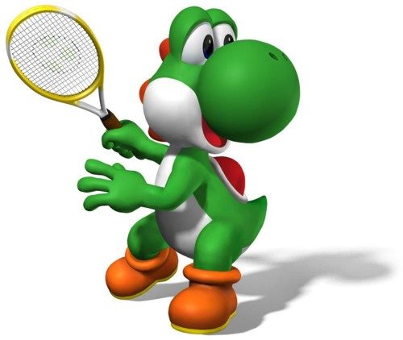
TRAIN DATA Table 1. Weather
Case Study
No | Outlook X1 | Temperature X2 | Humidity X3 | Wind X4 | Play Tennis? Y
1 | Sunny | High | High | False | No
2 | Sunny | High | High | True | No
3 | Overcast | High | High | False | Yes
4 | Rain | Mild | High | False | Yes
5 | Rain | Low | High | False | Yes
6 | Rain | Low | Normal | True | No
7 | Overcast | Low | Normal | True | Yes
8 | Sunny | Mild | High | False | No
9 | Sunny | Low | Normal | False | Yes
10 | Rain | Mild | High | False | Yes
11 | Sunny | Mild | Normal | True | Yes
12 | Overcast | Mild | High | True | Yes
13 | Overcast | High | Normal | False | Yes
14 | Rain | Mild | High | True | No

Slide 6
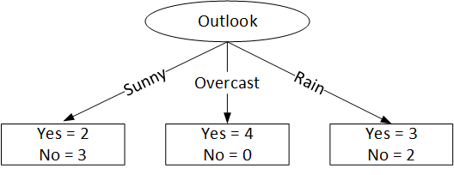
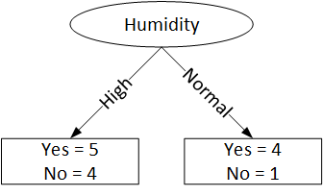
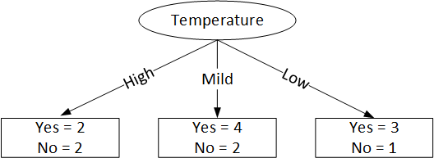
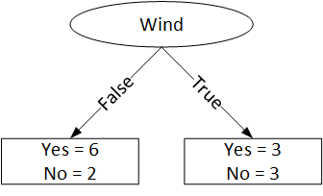
Attribute Selection Independently

Slide 7
ENTROPY
Before we find the information gain, we need to find the bits of information value in a group of objects using the entropy concept.
Entropy defines the impurity of an objects group.

Slide 8
ENTROPY
A given group of objects labelled y containing class 1,2, …, n, the entropy of the objects can be found using the formula:
Where p₁,p₂,…,p_{n} define the proportion of class 1, class 2, …, class n in the output.

Slide 9
ENTROPY
Based on the data in Table 1, the variable y contains of 9 “Yes” and 5 “No”, thus the entropy:
If there are two classes having same ratio, then the entropy will be 1.
If a set of objects having only one class, then the entropy will be 0

Slide 10
ENTROPY
The entropy of each class
Outlook = sunny
entropy[2,3] = 0.971 bits
Outlook = overcast
entropy[4,0] = 0 bits
Outlook = rain
entropy[3,2] = 0.971 bits
Entropy (weather) = 0.694 bits

Slide 11
A. INFORMATION GAIN
Information gain can be achieved from the data output or dependent variable (y) grouped based on an attribute A, so called gain(y,A).
Information gain, gain(y,A) of an attribute A to the data output y is :

Slide 12
A. INFORMATION GAIN
Based on table 1, we choose Wind as the attribute A containing 9 “Yes” and 5 “No”.
value(A) = [false, true]
y = [9, 5]
y_{false} ← [6, 2]
y_{true} ← [3, 3]

Slide 13
A. INFORMATION GAIN

Slide 14
A. INFORMATION GAIN
The information gain of all attributes:
Outlook = 0.247 bits
Temperature = 0.029 bits
Humidity = 0.045 bits
Wind = 0.048 bits

Slide 15
A. INFORMATION GAIN
The information gain of all attribute shows that attribute having the highest gain(y,A) is:
Outlook = 0.247 bits
Thus the attribute of outlook is selected as the first split attribute in the Decision Tree

Slide 16
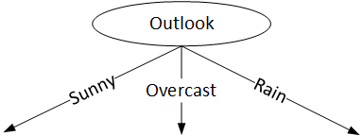
A. INFORMATION GAIN
First splitting in the Decision Tree

Slide 17
A. INFORMATION GAIN
Next, we need to re-iterate for each class of the Outlook.
In the class of Sunny, we find the gain(y,A) for the attributes of x₂, x₃, and x₄.
Information gain, gain(y,A):
Gain(temperature) = 0.571 bits
Gain(humidity) = 0.971 bits
Gain(wind) = 0.02 bits

Slide 18
A. INFORMATION GAIN
The value of each information gain shows that the highest gain(y,A) is :
Gain(humidity) = 0.971 bits
Thus the attribute of humidity is selected in the second split of the edge Outlook = sunny.

Slide 19
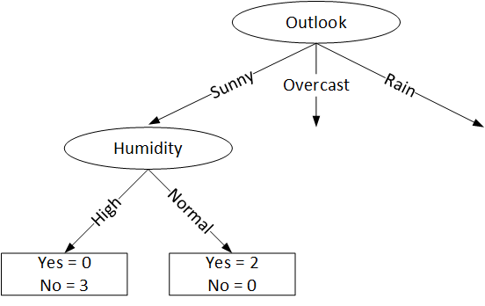
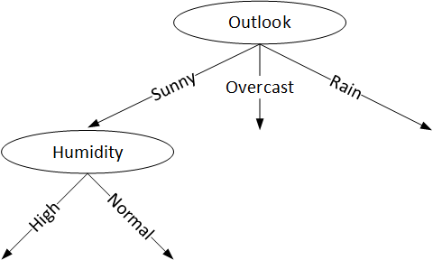
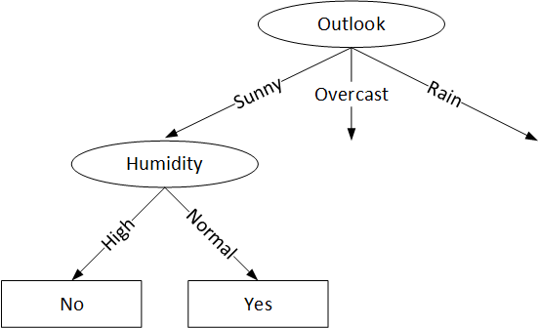
A. INFORMATION GAIN
Second split in the Decision Tree

Slide 20
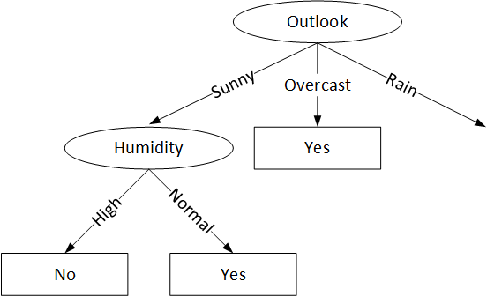
A. INFORMATION GAIN
Third split in the Decision Tree

Slide 21
A. INFORMATION GAIN
Re-iteration for the edge of Rain.
We find the gain(y,A) of each attribute x₂, x₃ and x₄.
The information gain, gain(y,A):
Gain(temperature) = 0.02 bits
Gain(humidity) = 0.322 bits
Gain(wind) = 0.971 bits

Slide 22
A. INFORMATION GAIN
We found that the highest information gain gain(y,A) for the edge of Rain is:
Gain(wind) = 0.971 bits
Thus the attribute of wind is selected as the split attribute for the edge of Outlook = rain.

Slide 23
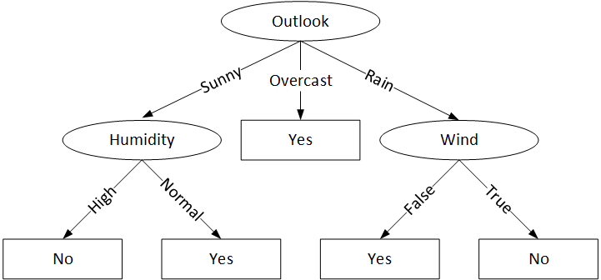
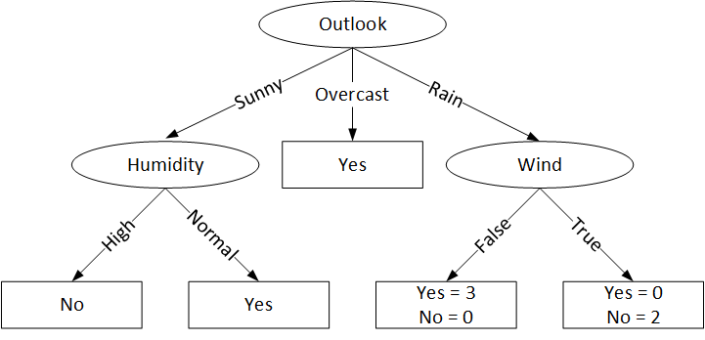
A. INFORMATION GAIN
The fourth split in Decision Tree

Slide 24
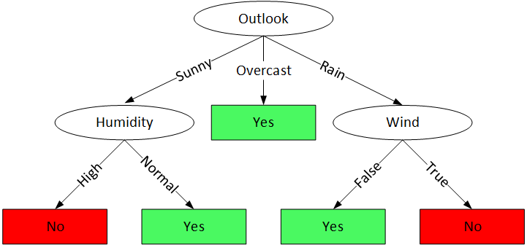
Decision Tree – Information Gain

Slide 25

It’s easy, right?

Slide 26
Please visit the link
https://www.youtube.com/watch?v=cKl7WV_EKDU

Slide 27
Assignment
Download a dataset from the following url.
http://archive.ics.uci.edu/ml/datasets.html
Choose a dataset having :
Default task = Classification
Attribute types = Categorical
No. of instances > 1000
No. of attributes > 5

Slide 28
Tugas
Lakukan klasifikasi pohon keputusan berdasarkan nilai Gain(y,A) terhadap data dari PR Anda sebelumnya!
Masing-masing mahasiswa membuat 5 bilangan bulat secara bebas antara 1 sampai dengan 100 yang ditulis dalam 5 lembar kertas (satu angka, satu lembar kertas)

Slide 29
Pemilihan Kriteria Atribut
Bagaimana Kriteria Lain ?
Kriteria Atribut
Information Gain
Gain Ratio
Indeks Gini
SOLVED
See you
next time

